Slide 1
TUM Venture Lab Quantum/Semicon QFP - Project Phase Introduction
25.03.25

Slide 2





ETH Quantum Hackathon Alice&Bob Challenge: Qubitli
Manuel Antoinette, Jan Jakob, Fabian Schatz
ETH, 11.05.2025

Slide 3

OUR FULL PIPELINE
Overview pipeline (Manuel)
Displacement strategy (Fabi) Fock states
Sampling strategy (radial sampling, etc) (why? Gradient, maxima, Minima)(Manuel)
Optimization (Jan)
Denoising strategy (Fabi)
Results
Noise analysis (Jan)

Slide 4
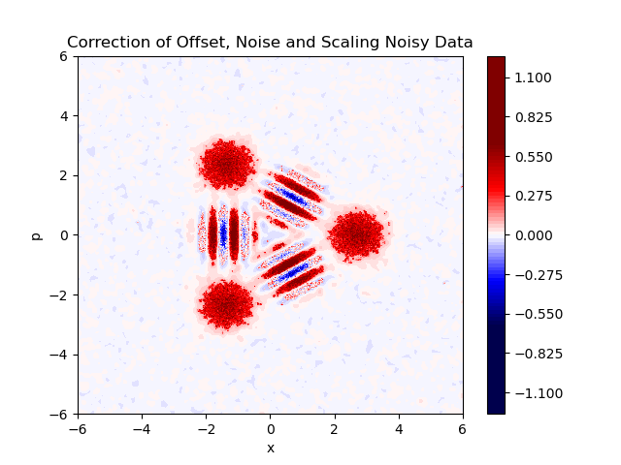
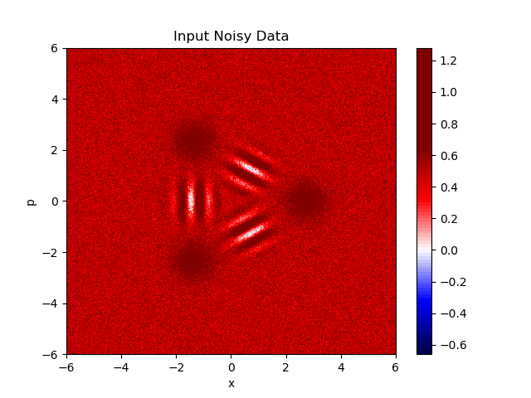
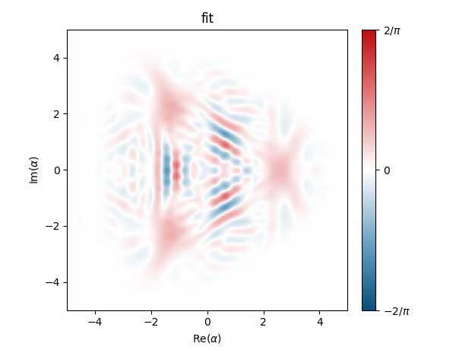
OVERVIEW

Slide 5
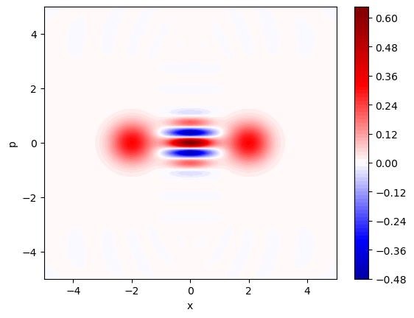
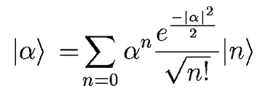
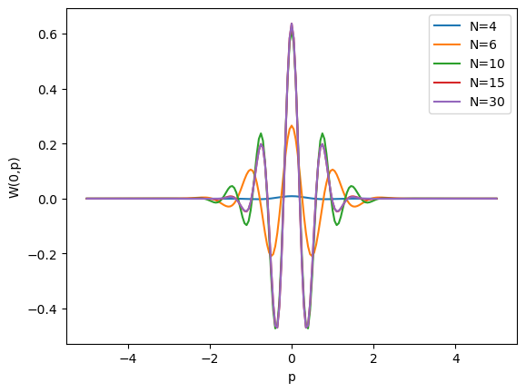
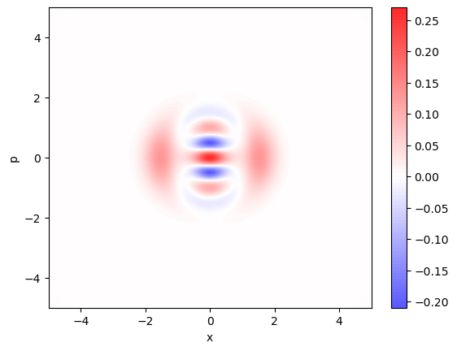
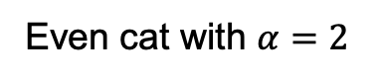
FOCK STATE TRUNCATION
Even cat with $α=2$
Fock state truncation
Approximation of states in terms of Fock states:
N=30
N=6

Slide 6
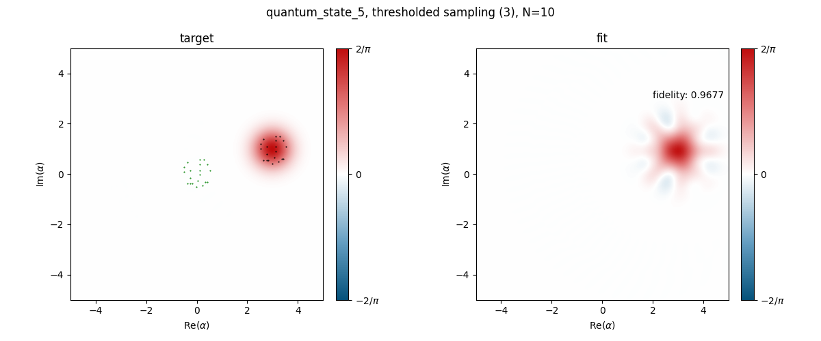
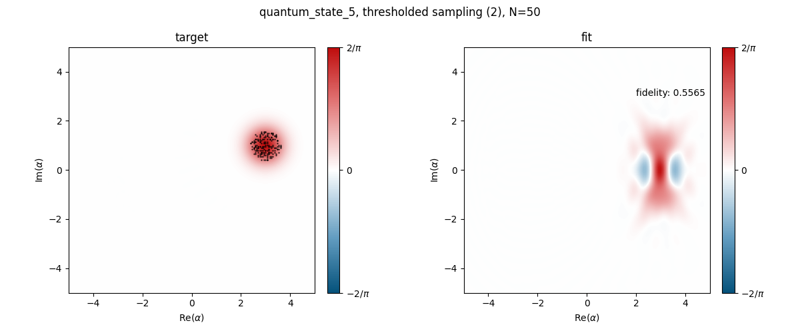
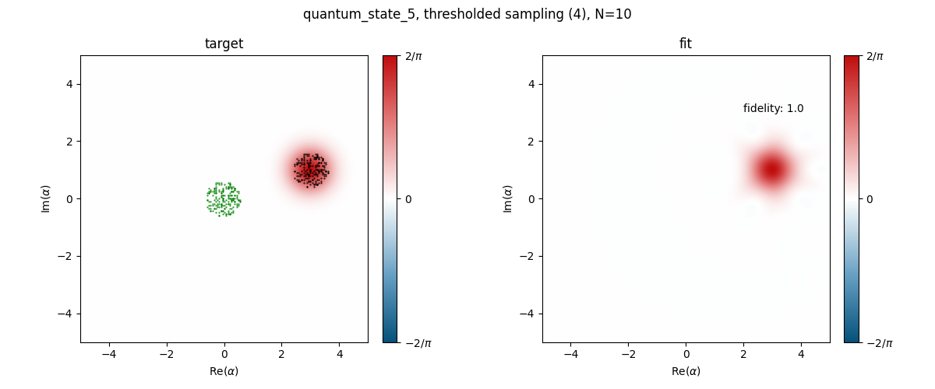
DISPLACEMENT STRATEGY

Slide 7
SAMPLING STRATEGY
Compare basic strategy grid sampling (show plot with rectangular sampling points) to strategy with advanced strategy

